Slide 1

How do you do Laundry in Space?
Assessing the Efficacy of Hydrogen Peroxide as a Disinfectant/Deodorizer in Combination with Silver Impregnated Textiles
Christina Morrison, Charles P. Gerba
University of Arizona

Slide 2
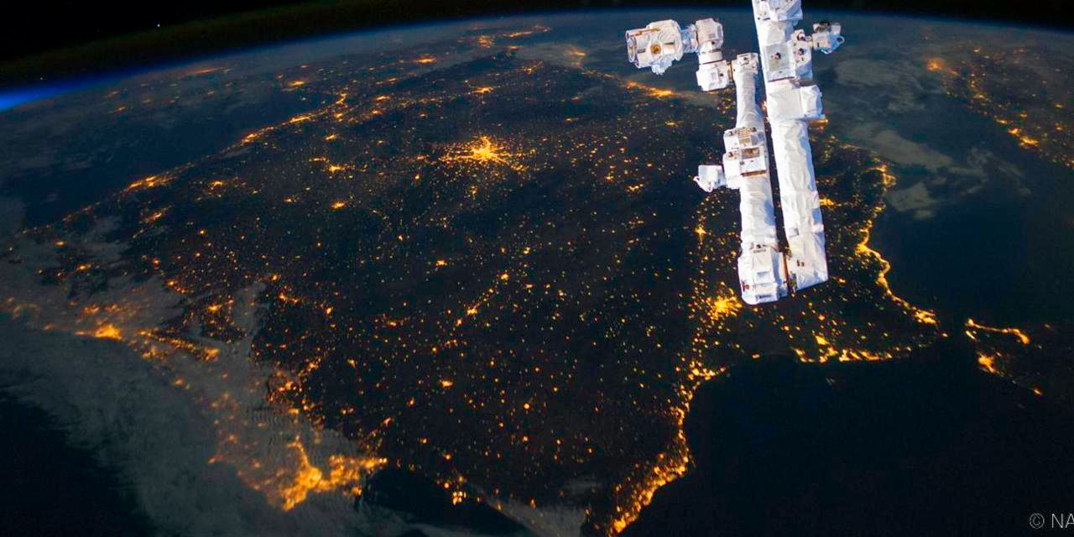

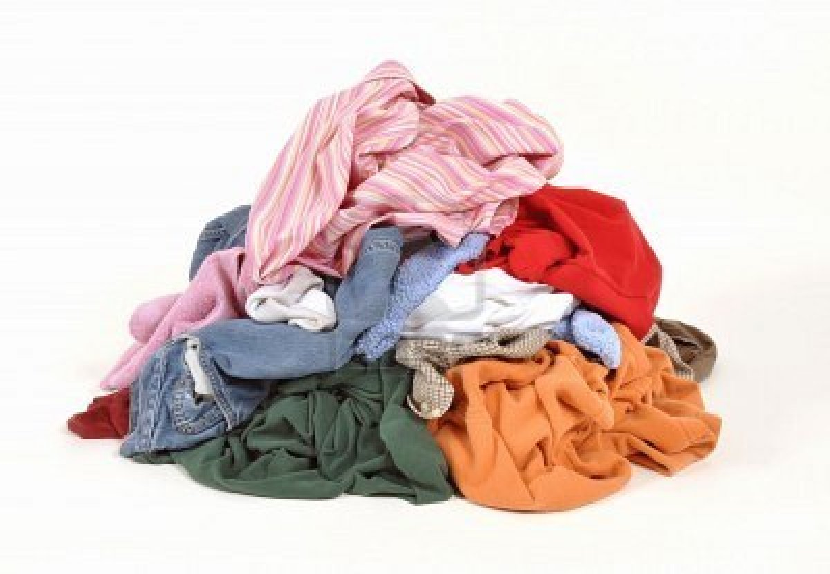

Introduction
Currently, there are few options for laundering clothing during space missions
  Reused & Disposed
Clothing accounts for a significant portion of launched mass
Extending clothing length of use can reduce amount of clothes needed during space missions

Slide 3
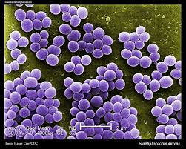
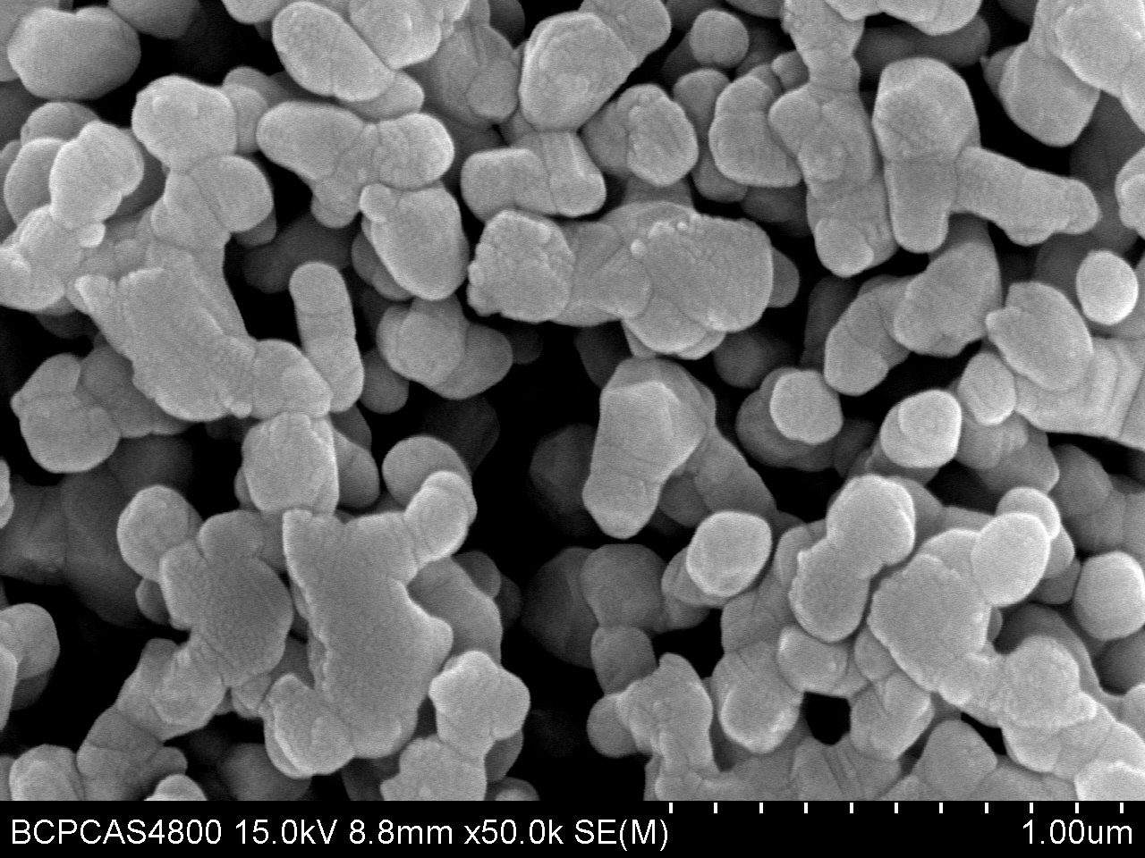
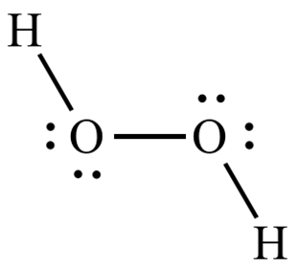
Background
What makes clothes dirty?
  Sweat
  Dead skin cells
  Bacteria
Many bacteria reside in/on human skin
  Staphylococcus spp.
Silver impregnated textiles have antimicrobial properties
  Silver is broad-spectrum antimicrobials
Silver combined with Hydrogen Peroxide (H₂O₂), a common disinfectant, has exhibited synergistic effects for disinfection of water
Notes:
Silver:
Demonstrates broad spectrum efficacy against in inactivating most common human bacterial and fungal pathogens.
Has been considered as an alternative to disinfection of water via chlorine during treatment.
Silver ions have the highest level of antimicrobial activity of all the heavy metals
Hydrogen Peroxide (H₂O₂):
3% H₂O₂ has been used as a topical antiseptic for many years.
Demonstrates broad-spectrum efficacy against bacteria and other microorganisms.
Is considered a less harmful disinfection method due to breakdown products of water and oxygen
Silver and H2O2, combined:
Has exhibited “synergistic” tendencies when combined for use in disinfection of water

Slide 4
Objective
This study aims to assess the antimicrobial efficacy, both quantitatively and qualitatively, of silver-ion impregnated textiles when treated with hydrogen peroxide

Slide 5
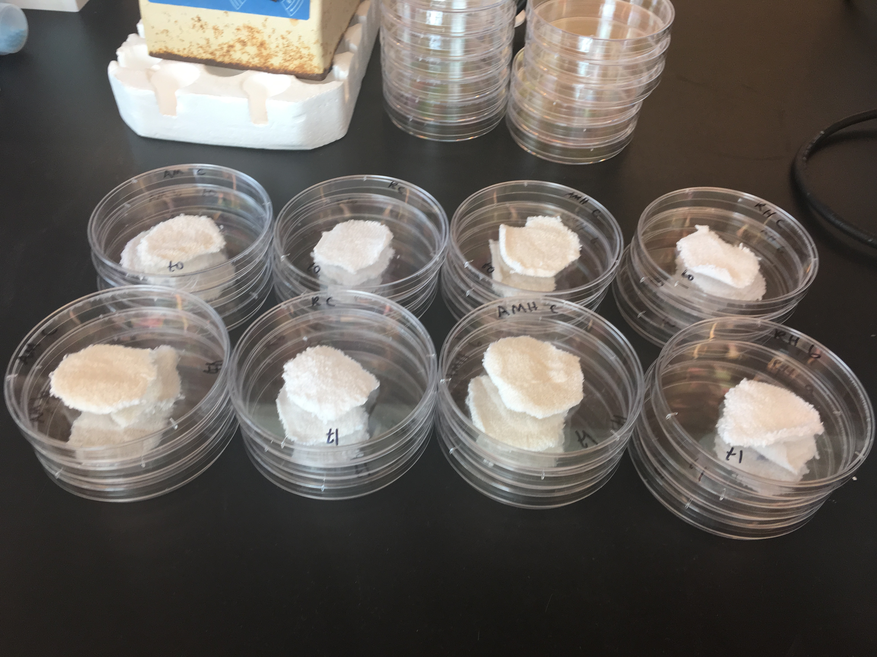
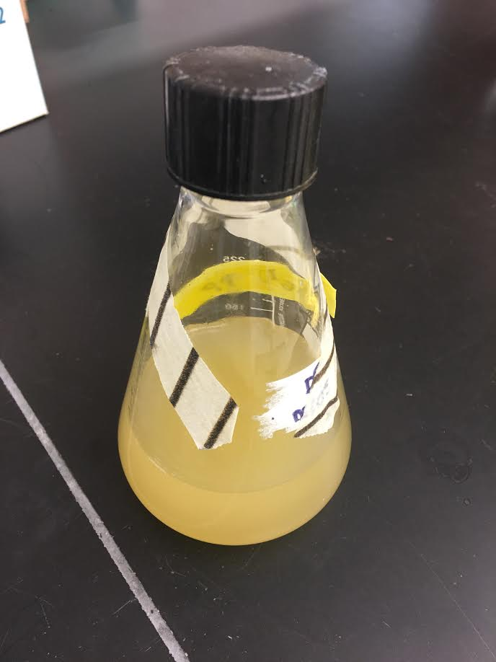
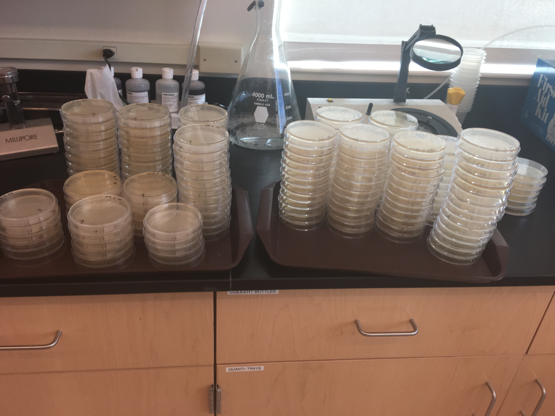
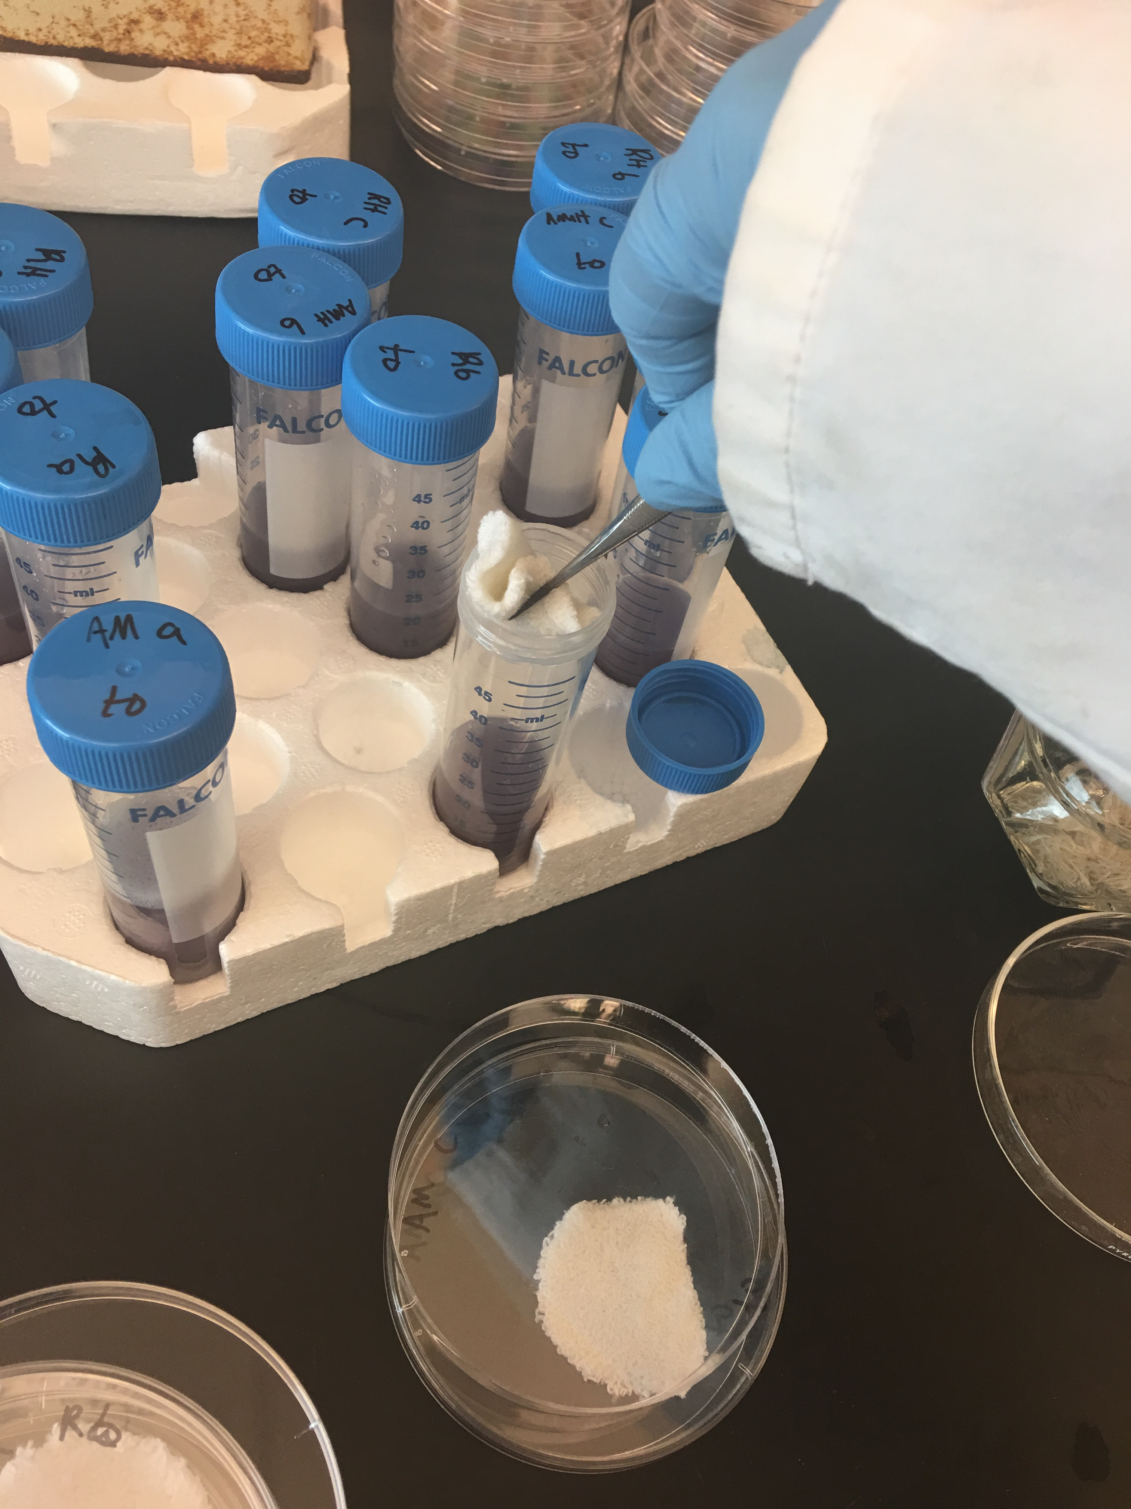
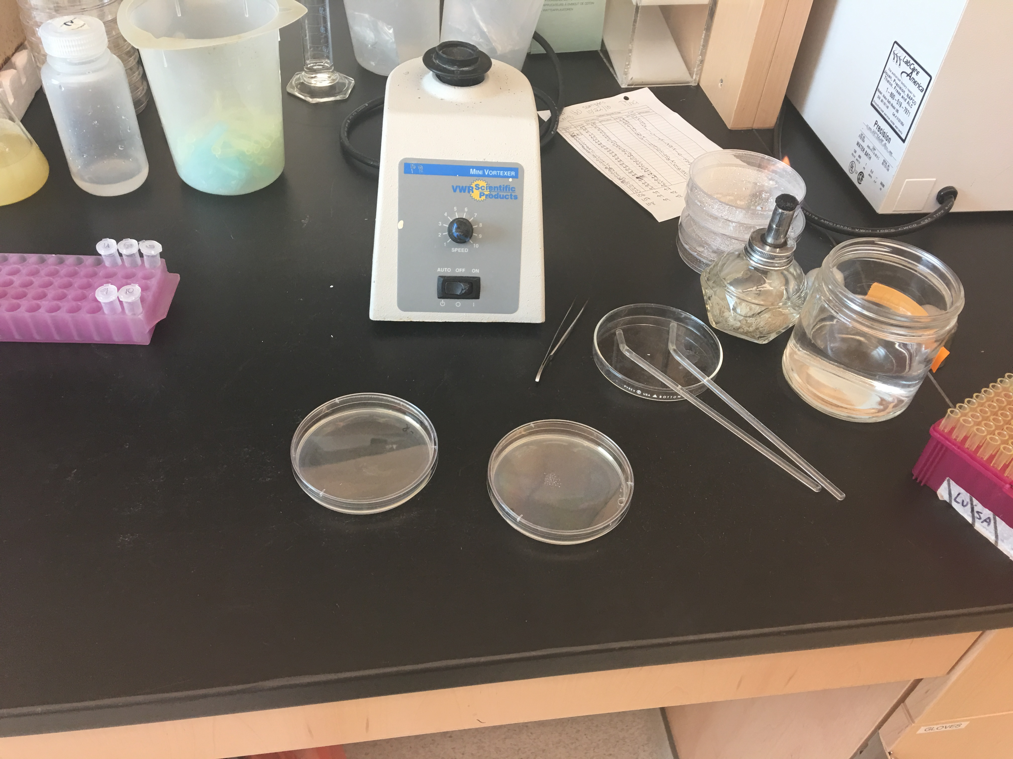
Methods
AATCC Test Method 100-2004
  “Antibacterial Finishes on Textile Materials: Assessment of”
Two textiles:
  Antimicrobial (AM): Silver-ion impregnated (PurThread)
  Non-Antimicrobial (Non-AM): Synthetic Blend (Gildan)
4.8cm diameter swatches
All swatches inoculated with 2mL of Staphylococcus aureus (Appx 1x10⁶ cfu/mL)
One set of AM & Non-AM left untreated, other set treated with H₂O₂ at varying concentrations and contact times
Swatches are placed in 20mL 2X D/E Neutralizing Broth and vortexed for 30 seconds
Enumeration via spread plate method on Tryptic Soy Agar (TSA) media
Incubation at 37ºC for 24 hours
Notes:
AATCC = American Association of Textile Chemists and Colorists

Slide 6
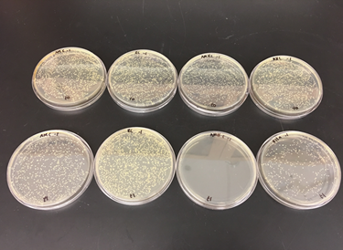
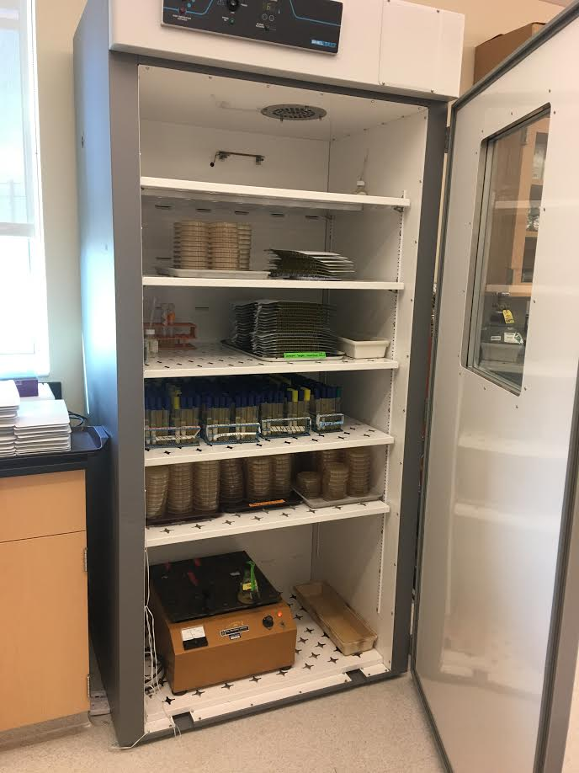
Methods (cont’d)
H₂O₂ Concentrations:
  3%, 1% & 0.5%
Contact Times:
  20 mins, 40 mins & 60 mins
Contact Conditions:
  37ºC & 44% RH
Controls:
  AM, Non-AM, AM + H₂O₂, and Non-AM + H₂O₂ inoculated and assayed immediately
  Untreated AM & Non-AM followed through contact period

Slide 7
Results: 3% H₂O₂
Notes:
60 min contact time:
AM + H₂O₂ significantly larger log reduction than Non-AM + H₂O₂, AM (no treatment) and Non-AM (no treatment)
(P = 0.003, P = 4.5x10⁻⁵, and P = 3.6x10⁻⁵, respectively

Slide 8
Results: 1% H₂O₂

Slide 9
Results: 0.5% H₂O₂

Slide 10
Results: Synergy
Synergistic effects were exhibited between silver and all concentrations of H₂O₂ for one hour contact times
  3% (P = 0.0056)
  1% (P = 0.0053)
  0.05% (P = 1.94x10⁻⁵ )

Slide 11
Results: Synergy
Synergistic effects were exhibited between silver and all concentrations of H₂O₂ for one hour contact times
  3% (P = 0.0056)
  1% (P = 0.0053)
  0.05% (P = 1.94x10⁻⁵ )

Slide 12
Results: Synergy
Synergistic effects were exhibited between silver and all concentrations of H₂O₂ for one hour contact times
  3% (P = 0.0056)
  1% (P = 0.0053)
  0.05% (P = 1.94x10⁻⁵ )

Slide 13
Conclusions
Silver impregnated socks treated with H₂O₂ (all concentrations) exhibit significantly higher log reduction levels when treated for at least 60 minutes.
H₂O₂ alone has significantly higher log reductions when compared to untreated textiles at 60 mins, though less than when combined with silver ions.
Hydrogen peroxide treatments less effective at lower concentrations and lower contact times.
Synergistic effects were exhibited for all concentrations of H₂O₂ at 60 min contact time.

Slide 14
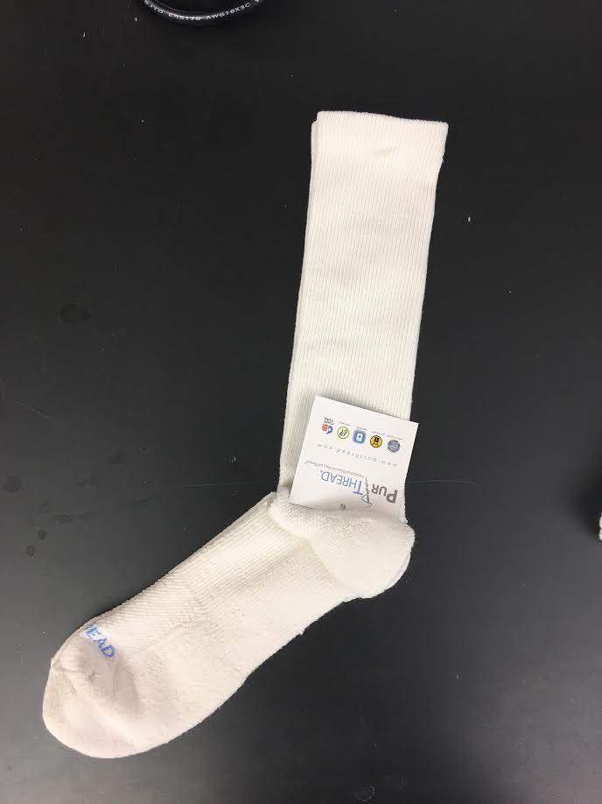
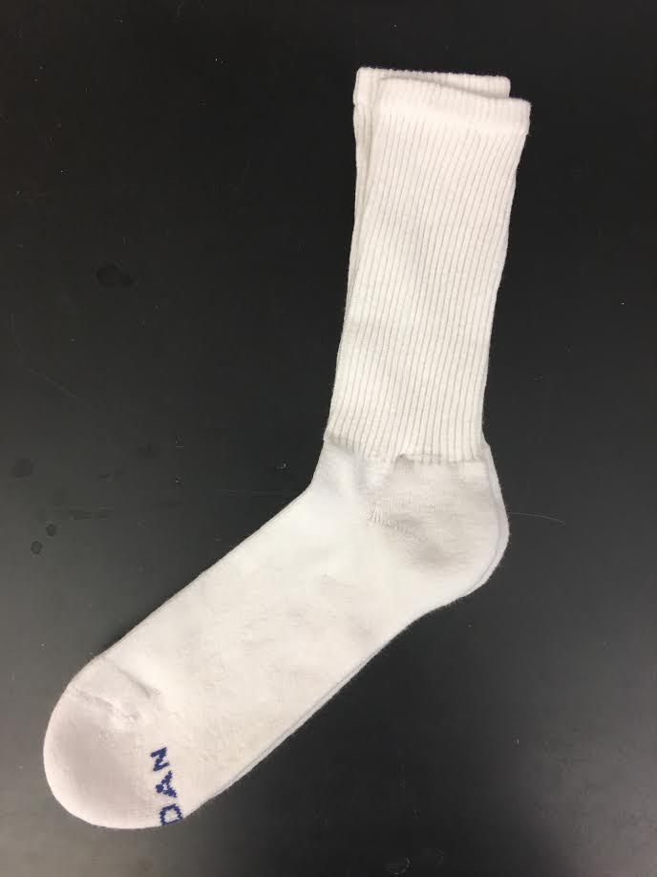
Future Work
Qualitative Testing
  Worn silver impregnated socks and non-antimicrobial treated for one hour with 3%, 1%, and 0.5% H₂O₂
  Olfactory panel will assess odor of treated and untreated, AM & Non-AM sock swatches.

Slide 15
Thank You
Questions?

